Slide 1


SAP CLOUD APPLICATION PROGRAMMING AND XSA TRAINING IN BPT
Anubhav Oberoy
Day – 6

Slide 2

Agenda – Day 6
Introduction to Views in SAP CAP
Why we need Views.
Introduction to OData
Understanding the use of OData services
Implementing OData service
Introduction to OData V2 Proxy
Converting OData V4 to OData V2
Introduction to Postman Tool
Check the CURD operations using the Postman.

Slide 3
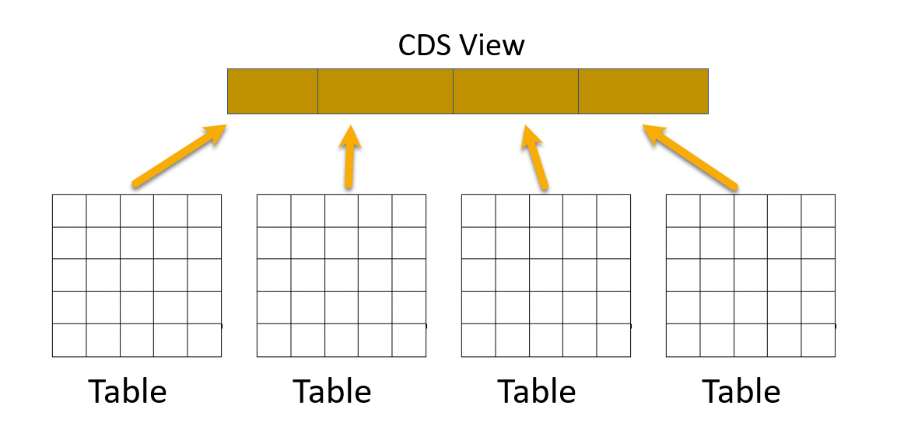
Introduction to Views in SAP CAP
Core Data Service (CDS) Views are virtual data models of SAP HANA which allows direct access to underlying tables of the HANA database.
SAP CDS Views aim to push logic from the application server to the client-side and database. This is defined by SAP as ‘Code -to-Data’ or ‘Code Pushdown’.
CDS Views is an important technology for modern application development on SAP systems and should not be overlooked. They provide enhancements in terms of data modelling and enable improved performance when combined with SAP HANA database.
CDS Views allow developers to create semantically rich data models which the application services expose to UI clients.
While the data in SAP is still physically stored in transparent tables, CDS Views are an abstraction layer on top of the tables for data modelling purposes. They understand the relationship between database tables and hide the complexity from the programmer.

Slide 4
Why we need views in a software
They display non-normalized data. The data is spread in multiple tables, and it is difficult for developers to every time write JOINs.
The application needs data which is presentable to user
View gives security because users cannot update data using view
They can aggregate data like find total sales per customer.
Expose columns of technical type to more semantic names
Syntax of defining Views
Use the as select from variant to use all possible features an underlying relational database would support using any valid CQL query including all query clauses.
Case Insensitive Naming of the View
Case Sensitive Naming of the View
define view ViewName as
select from table{
};
define view! [ViewName] as
select from table{
};

Slide 5
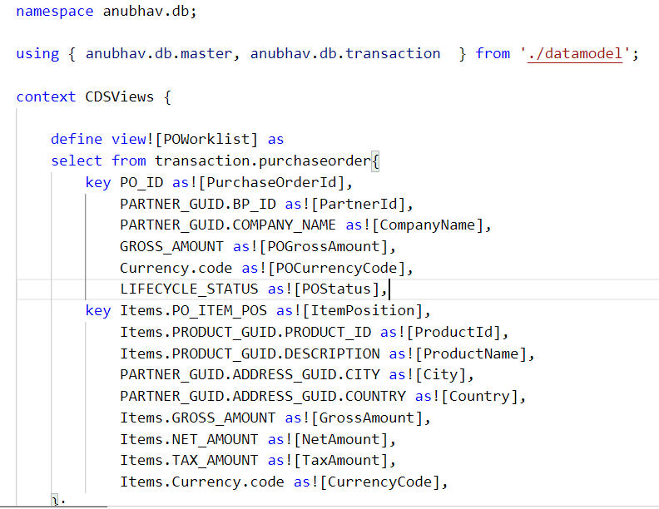
Hands-on: CDS Views
In this exercise we will create our first CDS View which will expose the non-normalized data for purchase order and purchase order items in combined form. We will expose this view using a new service named CDSService.
Exercise code/resource:
CDSViews.cds

Slide 6
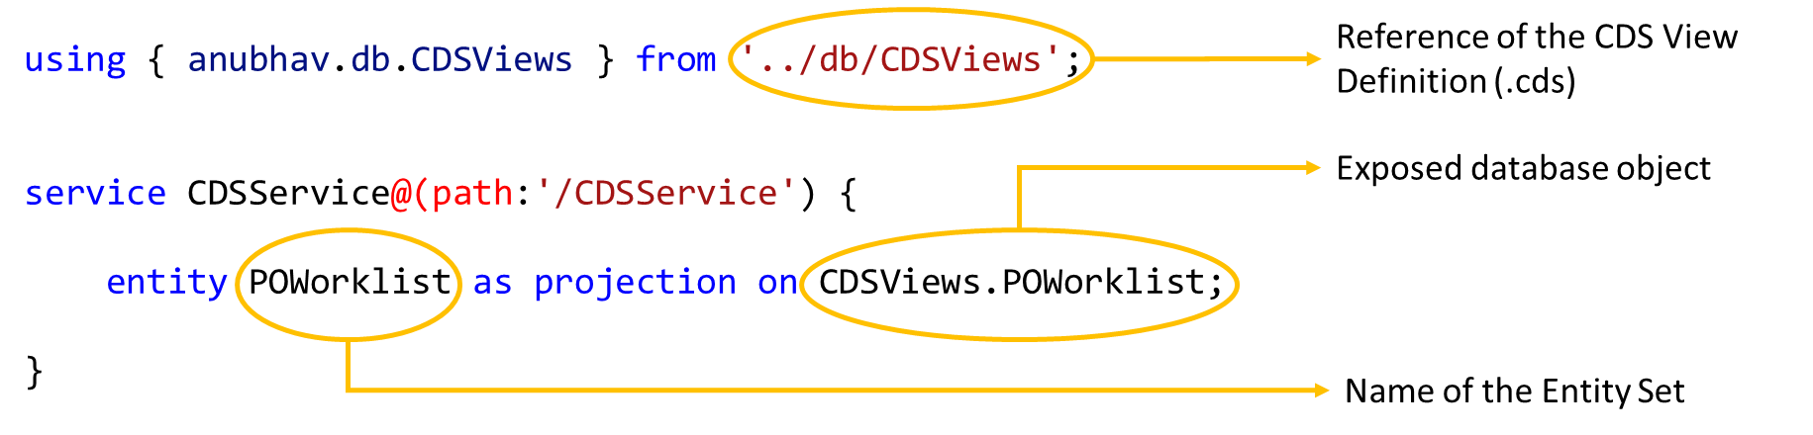
Exposing CDS Views in OData Entity Set
Syntax to Expose the CDS Views in OData Entity Set.
The syntax for exposing the CDS Views in the service is same as it is for the data model.
We just have to reference the CDS View Definition in place of the data model
And the CDS Views data object in place of the data models data object

Slide 7
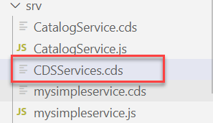
Exercise
In this exercise we will expose the data form the database in the form of OData by creating a OData service.
Steps to do the exercise.
Create a new file in /srv folder and name it as CDSServices.cds
Write the code to expose the cds view as service (past the code form below link)
Exercise Code/Resource:
CDSServices.cds

Slide 8
OData V2 Service
SAP CAP framework by default provides the OData V4 in the OData service.
But in most of the application developed in the Industry is based on the V2 version of the OData service.
OData V4 is only supported by the Fiori - List Report Application (LRP).
So, to over come this issue sap provides a module which converts the OData V4 generated by the CAP framework to the OData V2.
Npm module provided by SAP: - @sap/cds-odata-v2-adapter-proxy
This module can be install by using the command
npm install @sap/cds-odata-v2-adapter-proxy
Now to use this module, we have to make a file named server.js in the /srv folder.
In this folder we have to write a bootstrap code to use the OData V2.
SAP CAP Framework
OData V2 Adapter proxy
OData V4
OData V2

Slide 9
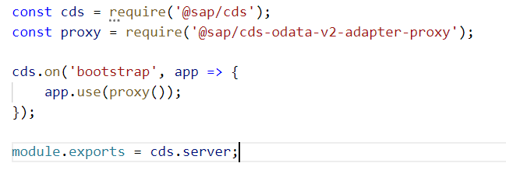
Hands-on: OData V2 Proxy
Create a new file server.js and write the bootstrapping code for the V2 adapter proxy.
Exercise Code/resource:
server.js

Slide 10

Introduction to POSTMAN Tool
Postman is an API platform for building and using APIs. Postman simplifies each step of the API lifecycle and streamlines collaboration so you can create better APIs—faster.
It is an interactive and automatic tool for verifying the APIs of your project.
It presents you with a friendly GUI for constructing requests and reading responses. ... Postman is the way to streamline the process of API testing.
Postman can run GET, POST, PUT, PATCH, MERGE, DELETE, and various other request methods as well, and has utilities to help with developing APIs. Free and paid versions are available for Mac, Windows, Linux, and as a Chrome app.
You can Download the postman tool from the link give below:
https://www.postman.com/downloads/

Slide 11
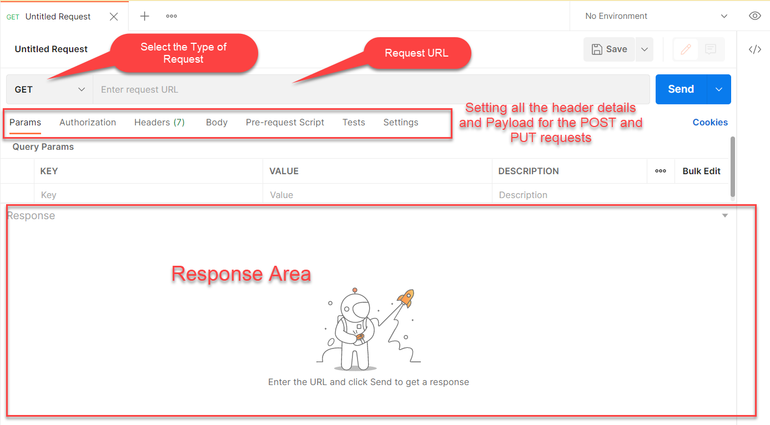
Postman App Layout
The below screen shot shows a basic layout of a request in Postman

Slide 12
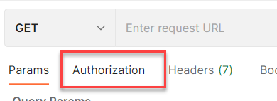
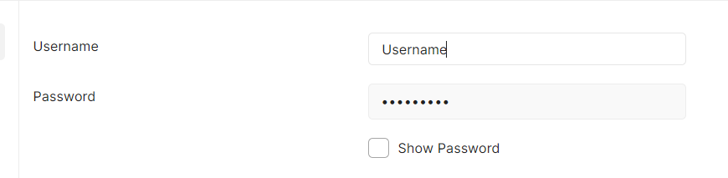
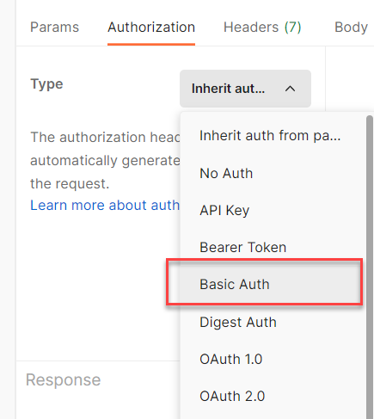
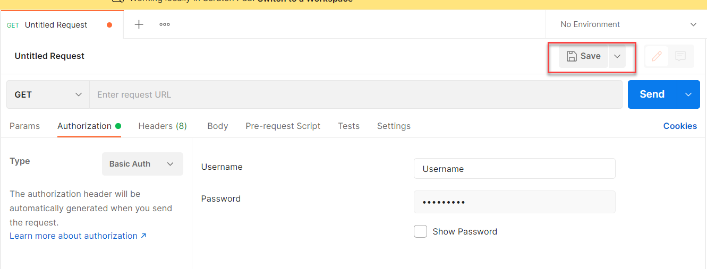
Setting Basic Auth in Postman
Step 1: Go to the Authorization section.
Step 3: Set the Username and Password.
Step 2: Select Basic Auth as Type
Step 4: Save.

Slide 13
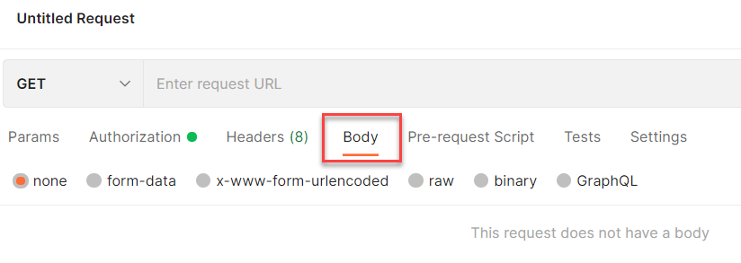
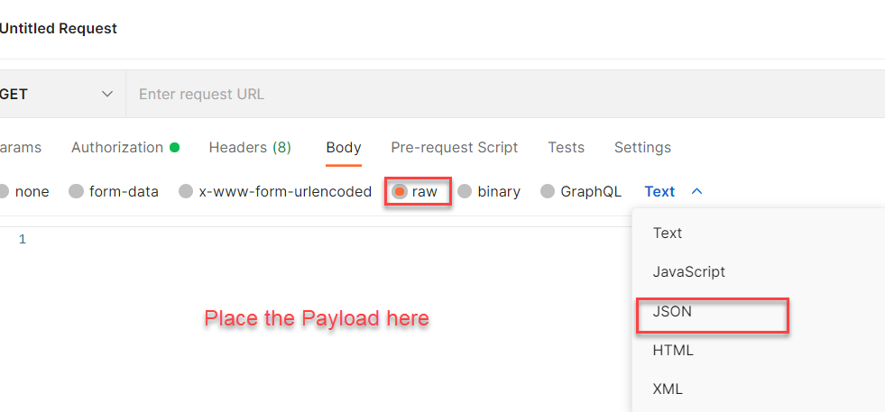
Setting the Payload for POST and PUT request
Step 1: Go to Body Section.
Step 2: Select the raw option form the radio button and then select the data type as JSON.

Slide 14

End of Day 6

Slide 15

Questions

Slide 16

Anubhav Oberoy

Slide 17


We’re committed to empower you to be
Most Desirable Resource
through powerful training solutions.
We build the workforce of the future.
250+
Corporate Clients
30,000+
Learners Trained
25000+
Learners Placed
FREE WEBINARS
Sign up for free webinars with industry experts every fortnight!
Enroll Now!
Contact us today!
https://anubhavtrainings.com/

Slide 18




More from AnubhavTrainings.com

Slide 19
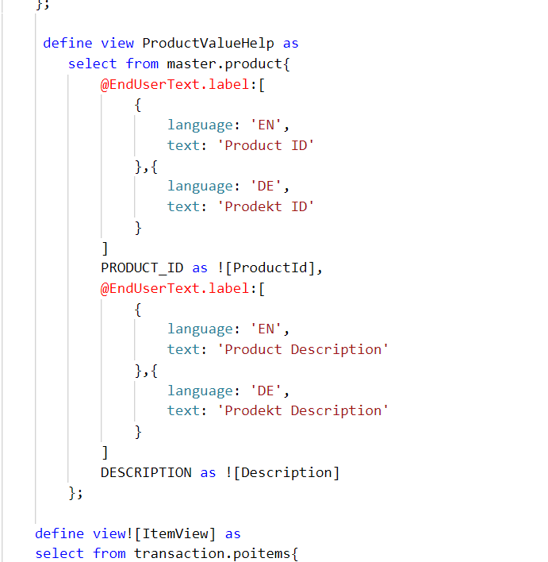
Hand-on: Advance CDS View
As we have seen the concept of views in SAP CAP. Now we will create some more views to understand the some advance concepts like creating Value Helps and View on View concept and expose them.
Exercise code/resources:
CDSViews.cds

Slide 20
Title
Content

